Slide 1
Java Collections Framework

Slide 2
Ways to Store Data
What if we need to store single element.
What if we need to store multiple elements.
Multiple elements can be stored using Collection.

Slide 3
What Is Collection?
Collection is simply an object that groups multiple elements into a single unit.
Array can do that!
So why Collection?
Consider a situation were we don’t want any duplicates in array OR we want array in sorted order.
This can be achieved using array, but will be complicated.
Collections makes it easy.
e.g. 1) Set don’t allow duplicate,
2) TreeSet gives sorted set
3) Arrays have a fixed size. ArrayList have a flexible size.
and so on..

Slide 4
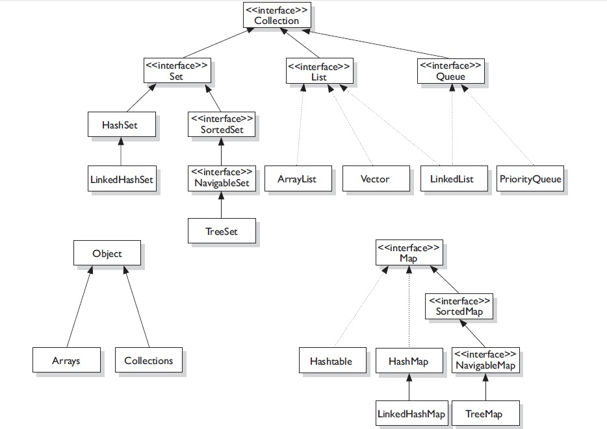
Collection Hierarchy

Slide 5
List
A List is an ordered Collection.
Lists may contain duplicate elements.
ArrayList
Vector
LinkedList

Slide 6
ArrayList
Resizable-array implementation of the List interface.
Its unsynchronized.
Allows null value.
Can create ArrayList as follow,
List myList = new ArrayList();
List myList = new ArrayList(int initialCapacity);
List myList = new ArrayList(Collection c);
Internally use Array of specified size OR default size(10).
When we try to add an element at the index greater than size of array, new Array is created with size 1.5*currentSize and the data from old Array is copied into this new Array.
Fast random access based on index.
Inserting or deleting an element is costly. (As index needs to be shifted.)

Slide 7
Vector
The Vector class implements a growable array of objects.
Vector is synchronized.
Allows null value.
Can create Vector as follow,
List v = new Vector();
List v1 = new Vector(int initialCapacity);
List v2 = new Vector(Collection c);
List v3 = new Vector(int initialCapacity, int capacityIncrement);
Internally use Array of specified size OR default size(10).
When we try to add an element at the index greater than size of array, new Array is created with size double the currentSize and the data from old Array is copied into this new Array.
Contains components that can be accessed using an integer index
Inserting or deleting an element is costly. (As index needs to be shifted.)

Slide 8
LinkedList
LinkedList is a chain of entities in which every entity knows about next-one and Previous-one.
Doubly-linked list implementation
Searching an element is slow, as need to traverse the list from the beginning or the end.
Inserting or deleting an element is cost effective as compared to ArrayList and Vector. (?)
Reason → No shift of index, just change in reference.
Not synchronized.
Allows null value.
Can create LinkedList as follow,
List l = new LinkedList();
List l = new LinkedList(Collection c);

Slide 9
Set
When we want collection which don’t have duplicate, Set comes into the picture.
Set won’t contain duplicate elements.
HashSet
LinkedHashSet
Treeset

Slide 10
HashSet
Un-Ordered set.
Allows null value.
Not synchronized.
HashSet uses HashMap internally(uses hashing mechanism ).
The backing HashMap instance has default initial capacity (16) and load factor (0.75).
Can create HashSet as follow,
Set s = new HashSet();
Set s = new HashSet(Collection c);
Set s = new HashSet(int initialCapacity);
Set s = new HashSet(int initialCapacity, float loadFactor);

Slide 11
HashSet Continued..
HashSet Uses HashMap internally. (how?)
public HashSet() {
map = new HashMap<>();
}
// Dummy value to associate with an Object in the backing Map
private static final Object PRESENT = new Object();
public boolean add(E e) {
return map.put(e, PRESENT)==null;
}
The put method will return,
1. null , if key is unique and added to the map. In turn add method of HashSet will return true 2. Old Value of the key , if key is duplicate. In turn add Method of HashSet will return false.

Slide 12
LinkedHashSet
LinkedHashSet maintains insertion order of elements.
Allows null value.
Not synchronized.
LinkedHashSet mechanism?
Doubly-linked list implementation.
Can create LinkedHashSet as follow,
Set s = new LinkedHashSet();
Set s = new LinkedHashSet(Collection c);
Set s = new LinkedHashSet(int initialCapacity);
Set s = new LinkedHashSet(int initialCapacity, float loadFactor);

Slide 13
TreeSet
The elements are ordered using their natural ordering, or by a Comparator provided at set creation time.
Not synchronized.
Null value not allowed.
TreeSet is bit slower because of sorting operation it needs to perform on each insertion.
Can create TreeSet as follow,
Set s = new TreeSet();
Set s = new TreeSet(Collection c);
Set s = new TreeSet(Comparator c);

Slide 14
Comparator Example
public class EmployeeSetSort {
int age;
String name;
public EmployeeSetSort(int age, String name){
this.age = age;
this.name = name;
}
public static void main(String arg[]){
EmployeeSetSort e1 = new EmployeeSetSort(24, "Hardik");
EmployeeSetSort e2 = new EmployeeSetSort(25, "Aaditya");
EmployeeSetSort e3 = new EmployeeSetSort(23, "Akshay");
//EmployeeSetSort e4 = new EmployeeSetSort(23, "Akshay");
Set<EmployeeSetSort> s = new TreeSet<EmployeeSetSort>(new EmployeeAge());
s.add(e1);
s.add(e2);
s.add(e3);
//s.add(e4);

Slide 15
Iterator<EmployeeSetSort> it = s.iterator();
for(int i=0; i<s.size(); i++){
EmployeeSetSort ee = it.next();
System.out.println(ee.age +" "+ ee.name);
}
}
}
class EmployeeAge implements Comparator<EmployeeSetSort>{
int result;
@Override
public int compare(EmployeeSetSort e1, EmployeeSetSort e2) {
return e1.age - e2.age;
}
}
O/P
23 Akshay
24 Hardik
25 Aaditya

Slide 16
Queue
Queues typically, but not necessarily, order elements in a FIFO (first-in-first-out) manner.
Lists may contain duplicate elements.
LinkedList
PriorityQueue
Queue methods,
add(e) – offer(e)
remove() – poll()
Element() – peek()

Slide 17
LinkedList
LinkedList implements the Deque interface, which Extends Queue interface.
A queue is ordered, and you'll only touch elements at one end.
Doubly-linked list implementation.
Deque methods,
addFirst(e) – offerFirst(e)
removeFirst() – pollFirst()
getFirst() – peekFirst()
addLast(e) – offerLast(e)
removeLast() – pollLast()
getLast() – peekLast()
not synchronized
Allows null values.
Can create LinkedList as follow,
Queue q = new LinkedList();
Queue q = new LinkedList(Collection c);

Slide 18
PriorityQueue
PriorityQueue Implements Queue Interface.
The elements of the priority queue are ordered according to their natural ordering, or by a Comparator provided at queue construction time.
A priority queue does not permit null elements.
A priority queue relying on natural ordering also does not permit insertion of non-comparable objects (doing so may result in ClassCastException).
not synchronized.
Can create PriorityQueue as follow,
Queue q = new PriorityQueue();
Queue q = new PriorityQueue(Collection c);
Queue q = new PriorityQueue(int initialCapacity);
Queue q = new PriorityQueue(int initialCapacity, Comparator comparator);

Slide 19
Thank You..

